Slide 1
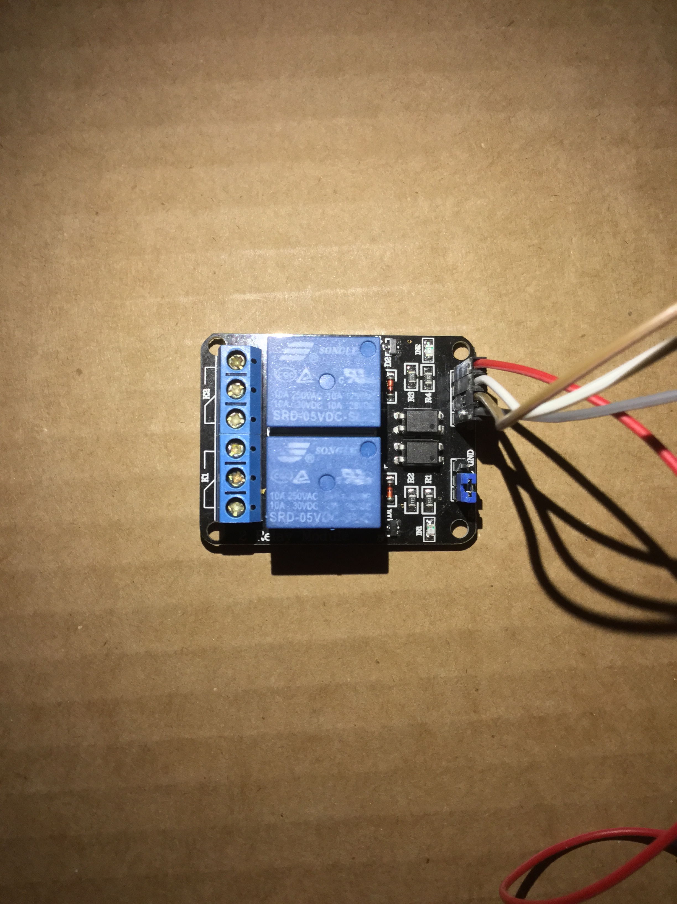
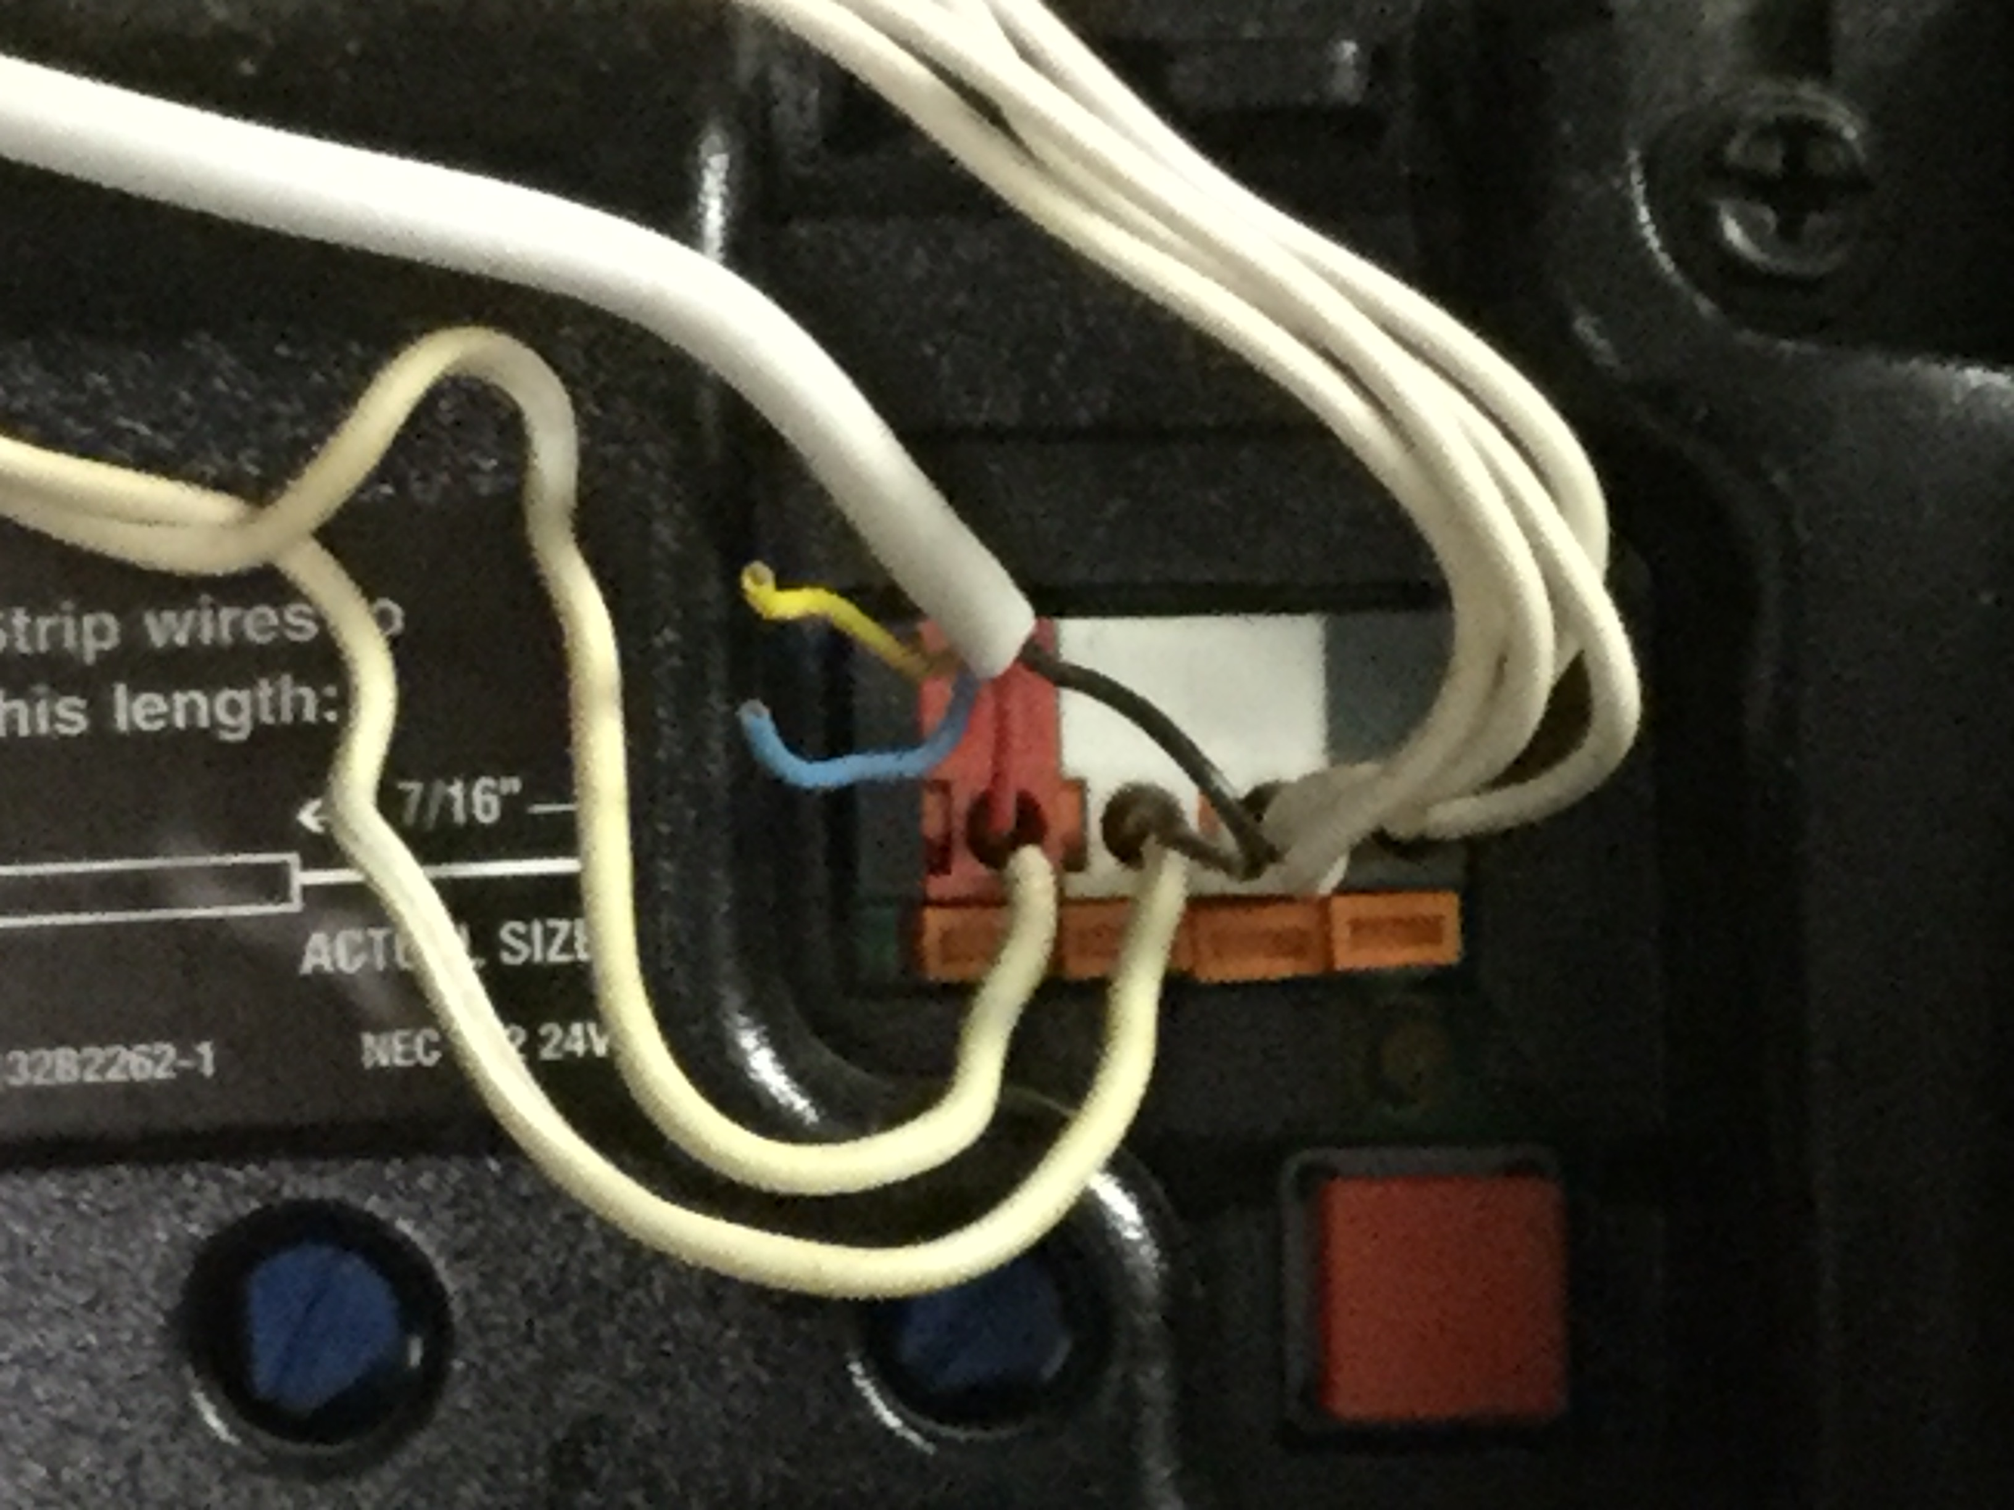
Garage Door Relay Switch Connections
Connect to 5v Pin
Connect to GND Pin
Connect 2 wires to door controller
GND
IN1
IN2
VCC
Shielded solid copper wire from terminal strip to door controller
Garage Door Switch to GPIO 5
Use the same connection as your existing garage door switch

Slide 2
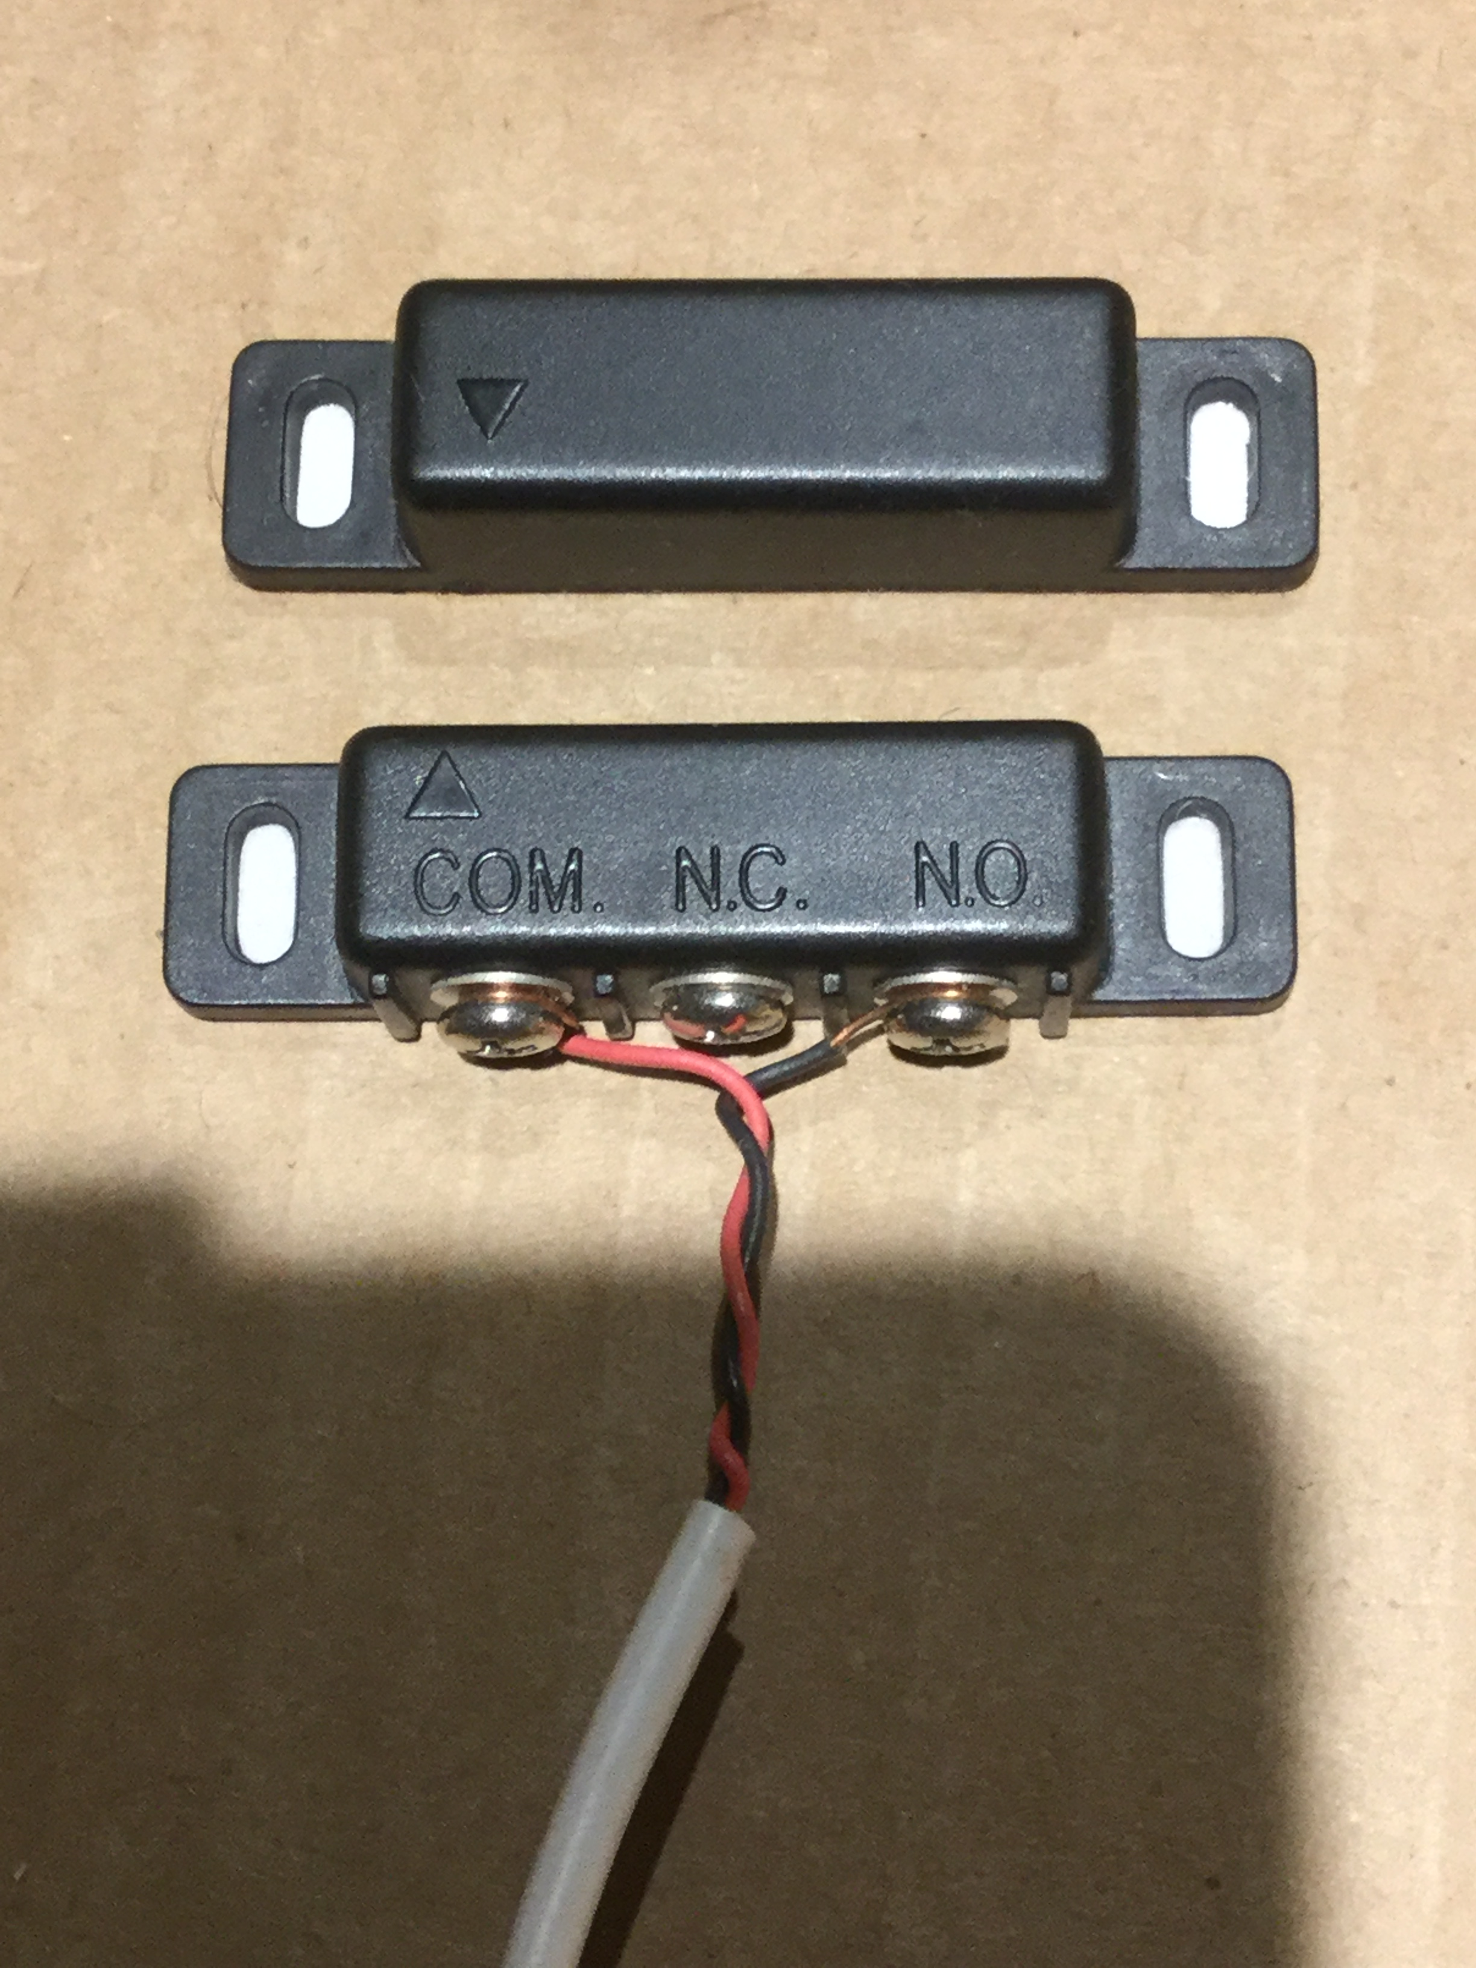
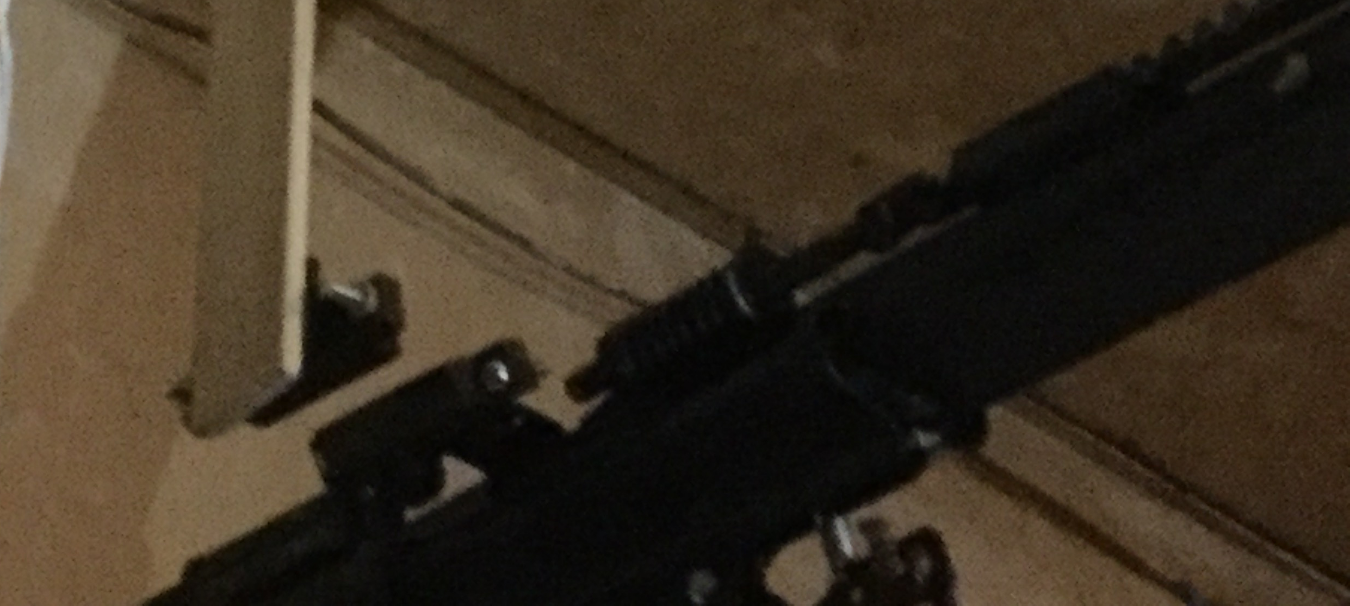
Garage Door Sensor Connections
Female jumper cables connect to GPIO Pins
Solid copper wire connects to female jumper
Connect to 3.3v Pin
Connect to GPIO 24
Distance between magnets needs to be at least 2mm
Magnet connected to trolley

